Slide 1
Death by a Thousand Leaks
What statically-analysing 370 Python extensions looks like
Presented by
David Malcolm
<dmalcolm@redhat.com>
Licensed under the Creative Commons Attribution-ShareAlike license: http://creativecommons.org/licenses/by-sa/3.0/

Slide 2


What is static analysis?
Discovering properties of a program without running it
Programs that analyze other programs
Treating programs as data, rather than code
In particular, automatically finding bugs in code

Slide 3
What kind of code will be analyzed?
For this talk:
The C code of
Python extension modules

Slide 4
Prerequisites
I’m going to assume basic familiarity with Python, and with either C or C++
Hopefully you’ve used, debugged, or written a Python extension module in C (perhaps via SWIG or Cython)

Slide 5
Outline
Intro to "cpychecker"
How to run the tool on your own code
How I ran the tool on lots of code
What bugs came up frequently
Recommendations on dealing with C and C++ from Python
Q & A

Slide 6

cpychecker
git clone \
git://git.fedorahosted.org/gcc-python-plugin.git
Docs: http://tinyurl.com/cpychecker
Part of my Python plugin for GCC
6500 lines of Python code implementing a static checker for C extension modules
See also my PyCon US 2012 talk: Static analysis of Python extension modules using GCC https://us.pycon.org/2012/schedule/presentation/78/

Slide 7

Reference counting
For every object:
  "what do I think my reference count is?" aka "ob_refcnt" (the object’s view of how many pointers point to it) versus
  the reality of how many pointers point to it
As a C extension module author you must manually keep these in sync using Py_INCREF and Py_DECREF.

Slide 8
Reference counting
The two kinds of bugs:
ob_refcnt too high
  memory leaks (hence the title of this talk)
ob_refcnt too low
  BOOM!!

Slide 9
Checking reference counts
For each path through the function and PyObject*, it determines:
  what the reference count ought to be at the end of the function (based on how many pointers point to the object)
  what the reference count is
It will issues warnings for any that are incorrect.

Slide 10
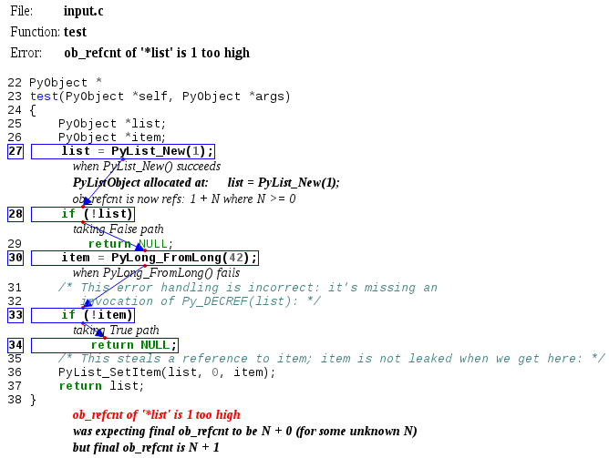

Slide 11

Limitations of the refcount checking
purely intraprocedural
  assumes every function returning a PyObject* returns a new reference, rather than a borrowed reference
    (...although you can manually mark functions with non-standard behavior)
  it knows about most of the CPython API and its rules

Slide 12
Limitations of the refcount checking (2)
only tracks 0 and 1 times through any loop, to ensure that the analysis doesn’t go on forever
can be defeated by relatively simple code (turn up --maxtrans argument)

Slide 13
What it checks for (2)
It checks for the following along all of those code paths:
Dereferencing a NULL pointer (e.g. using result of an allocator without checking the result is non-NULL)
Passing NULL to CPython APIs that will crash on NULL

Slide 14
What it checks for (3)
Usage of uninitialized local variables
Dereferencing a pointer to freed memory
Returning a pointer to freed memory
Returning NULL without setting an exception

Slide 15
What it checks for (4)
It also does some simpler checking:
type in calls to PyArg_ParseTuple et al
types and NULL termination of PyMethodDef tables
types and NULL termination of PyObject_Call{Function|Method}ObjArgs

Slide 16
What it doesn’t check for
(patches welcome!)
tp_traverse errors (which can mess up the garbage collector); missing it altogether, or omitting fields
errors in GIL handling
lock/release mismatches
missed opportunities to release the GIL (e.g. compute-intensive functions; functions that wait on IO/syscalls)

Slide 17
What it can’t check for
Does the code
"do the right thing"?

Slide 18
How to run it on your own code
git clone \
git://git.fedorahosted.org/gcc-python-plugin.git

Slide 19
Dependencies
(on Fedora)
sudo yum install \
gcc-plugin-devel \
python-devel \
python-six \
python-pygments \
graphviz

Slide 20
Building the checker
Building the checker:
make plugin
Checking that it’s working:
make demo

Slide 21
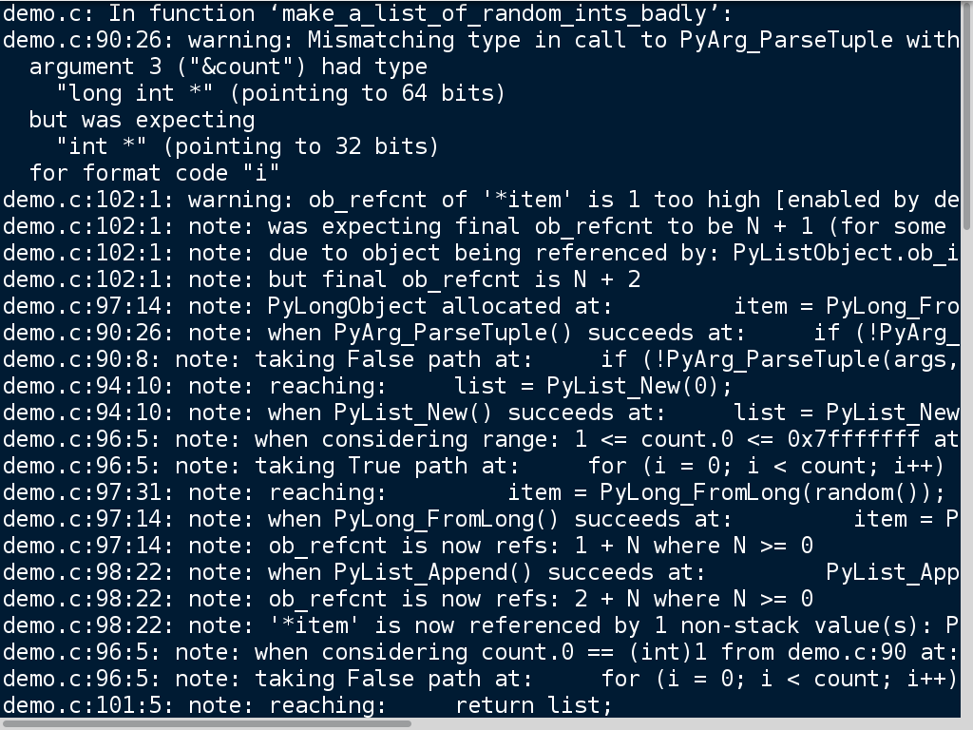

Slide 23
Building with it
Distutils
CC=/path/to/built/plugin/gcc-with-cpychecker \
python setup.py build
to set the environment variable
Makefiles
make CC=/path/to/built/plugin/gcc-with-cpychecker
to override the Makefile variable CC.

Slide 24
Let us know how you get on!
Mailing list:
gcc-python-plugin@lists.fedorahosted.org
See: https://fedorahosted.org/mailman/listinfo/gcc-python-plugin

Slide 25
Analyze all the things!
The goal: analyze all of the C Python extensions in a recent Linux distribution
  Specifically: all of the Python 2 C code in Fedora 17
    Every source rpm that builds something that links against libpython2.7
    370(ish) packages
The reality:
  Some unevenness in the data coverage, so take my numbers with a pinch of salt
  Lots of bugfixing as I went...

Slide 26
Running cpychecker a lot
Scaling up to hundreds of projects:
building via RPM
  hides the distutils vs Makefile vs CMake etc
"mock" builds
  every build gets its own freshly-provisioned chroot
Use this to reliably inject static analysis...

Slide 27
"mock-with-analysis"
Running checkers:
cpychecker
cppcheck
clang-analyzer
gcc warnings
https://github.com/fedora-static-analysis/mock-with-analysis

Slide 28
Scaling up (continued)
separation of model from presentation
  "Firehose" XML format:
  https://github.com/fedora-static-analysis/firehose
detect analyzers that fail or exceed 1 minute to run
store the result in a database
capture any sources mentioned in a report
can also capture arbitrary data e.g. code metrics

Slide 29
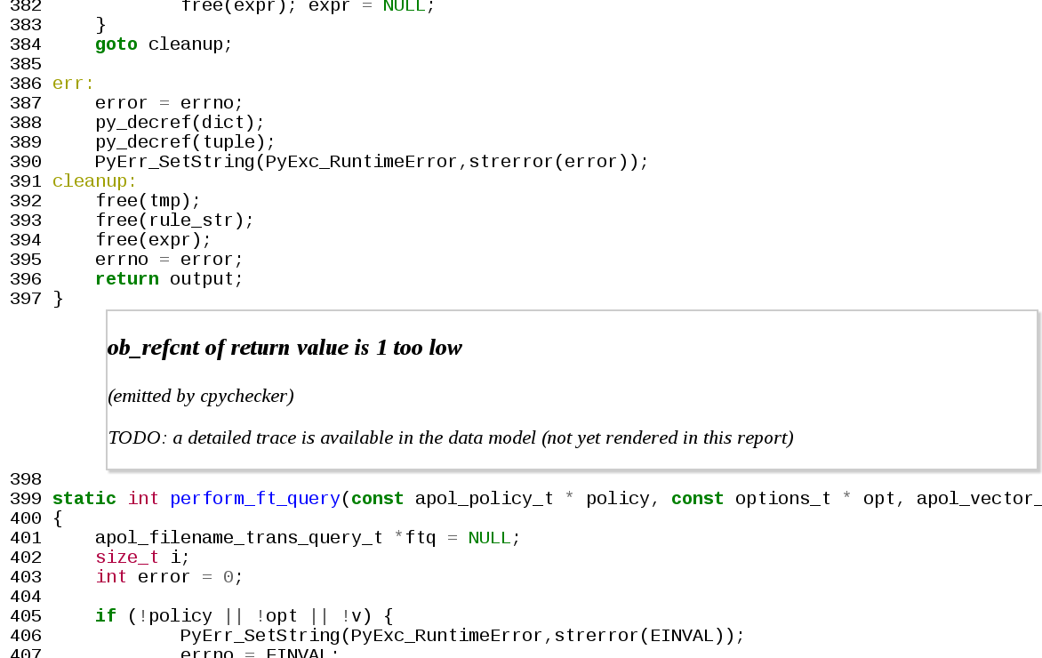

Slide 30
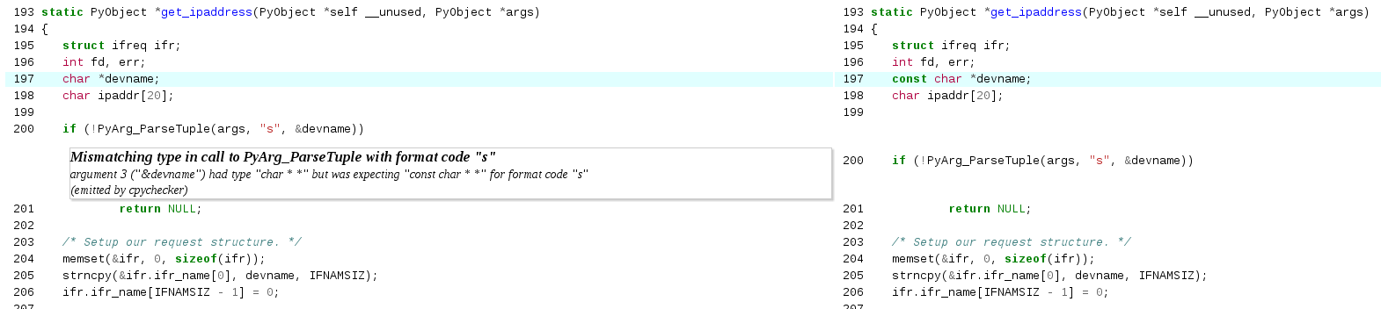

Slide 31
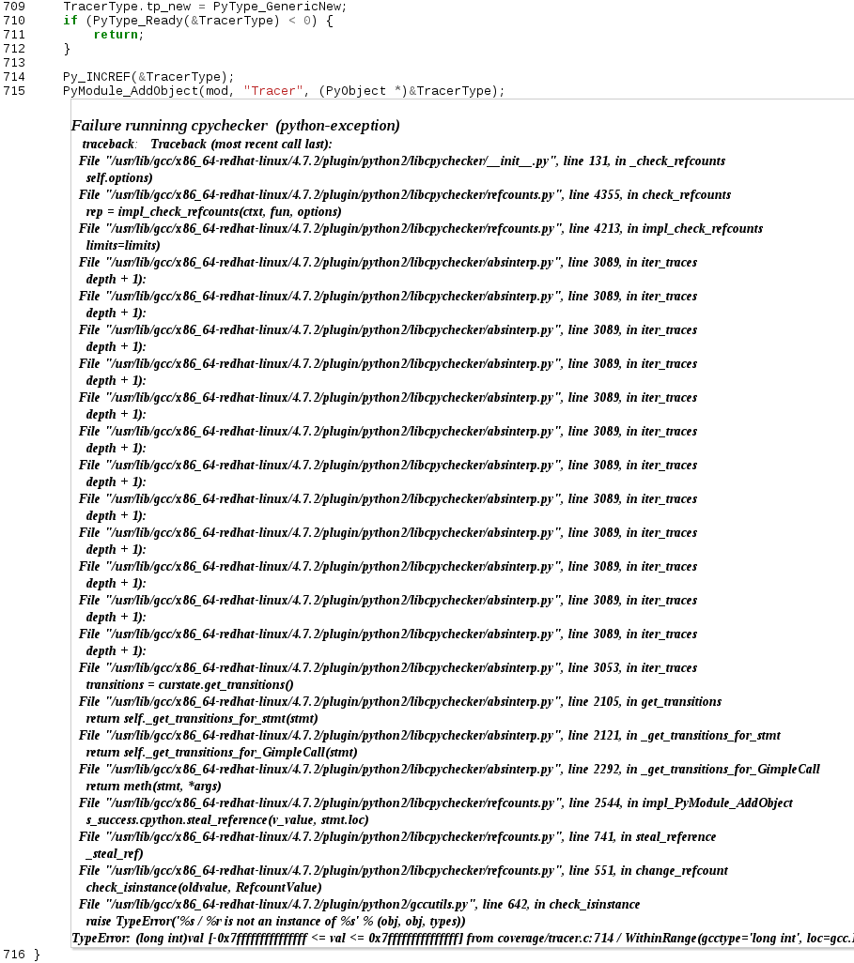

Slide 32
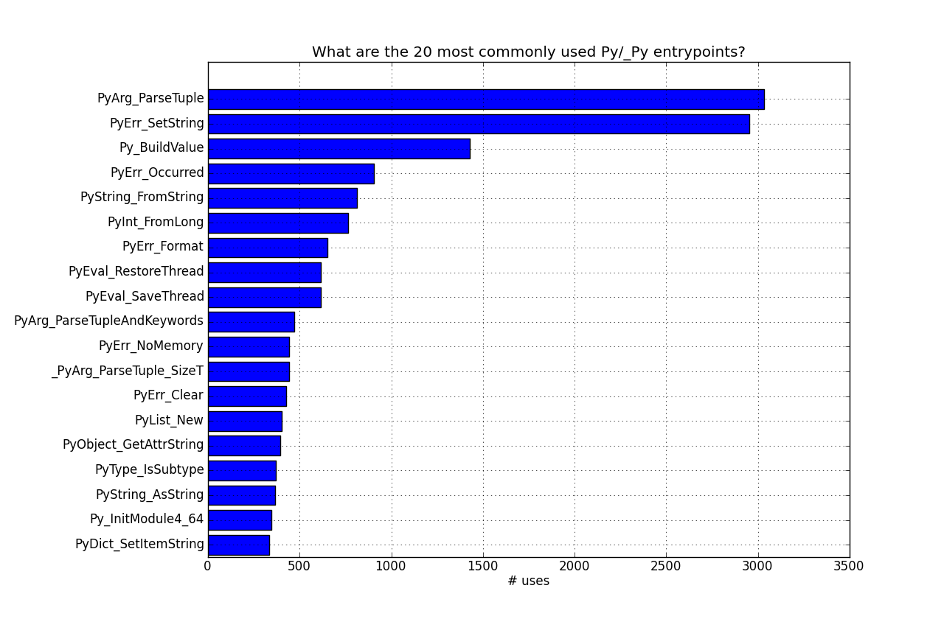

Slide 33
What are the least commonly used Py/_Py entrypoints?
There are many with just 1 user, but most of these are false positives:
about 50 actual CPython API entrypoints with just one user
about 100 "entrypoints" due to other projects reusing the prefix
(see source code of this talk if you’re interested in the data: https://github.com/davidmalcolm/PyCon-US-2013-Talk

Slide 34
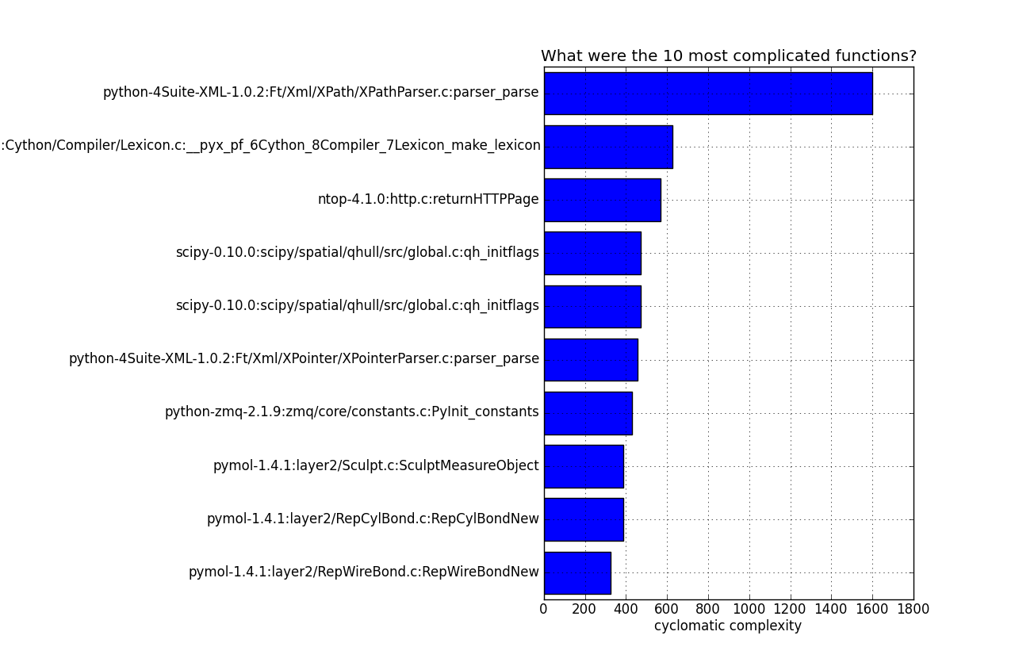

Slide 35
What did the analyzers complain about?

Slide 36
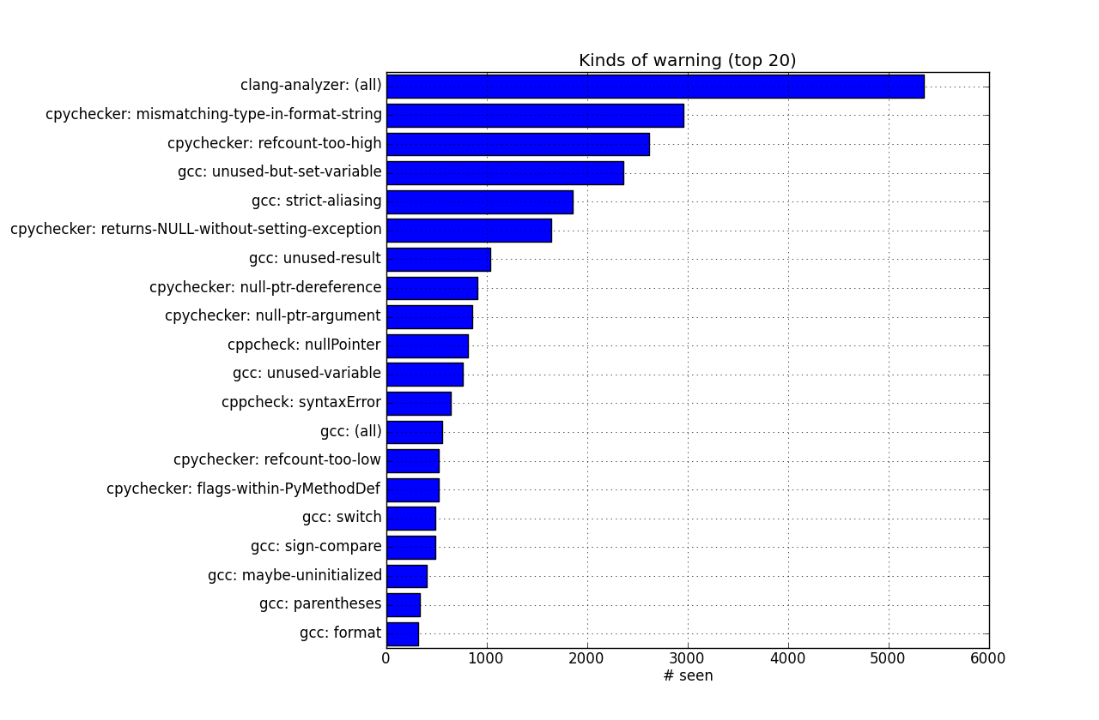

Slide 37
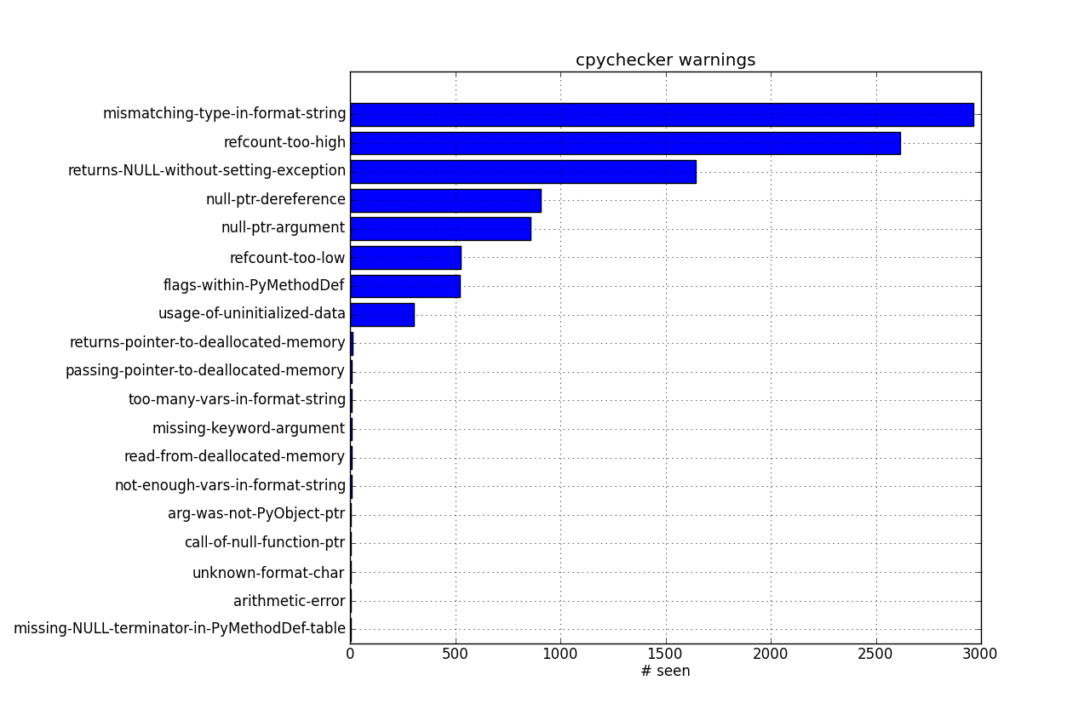
What did cpychecker complain about?

Slide 38
Reference-counting bugs

